Slide 1

Reata Glen SCIENCE DISCUSSION
2025-04-15
Alan Jones

Slide 2
Agenda
Science Humor
Science Quiz
Short items
Earthquake!
Healthspan

Slide 3
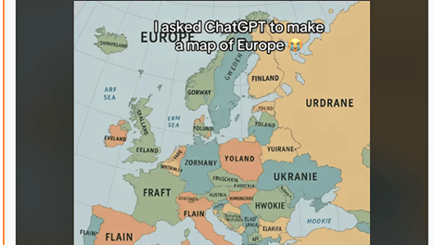

Slide 4
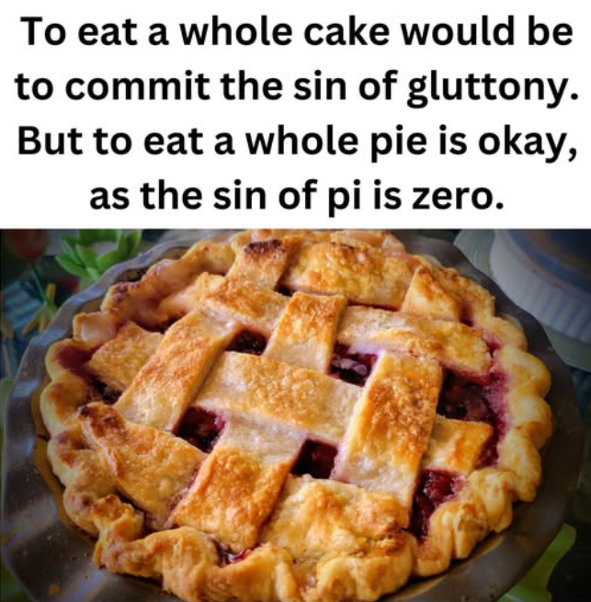

Slide 5
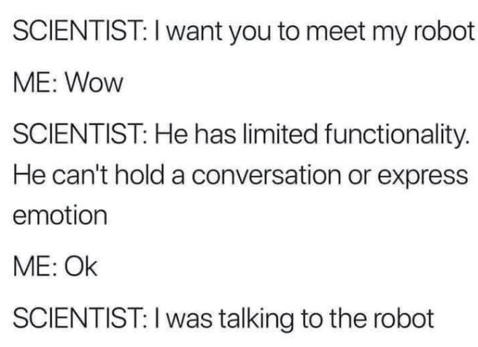

Slide 6
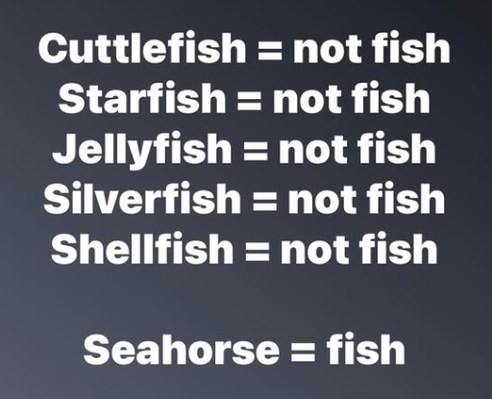

Slide 7
Scientific American Quiz
https://www.scientificamerican.com/game/science-quiz-extinction-encryption-hacks-2025-04-11/

Slide 8
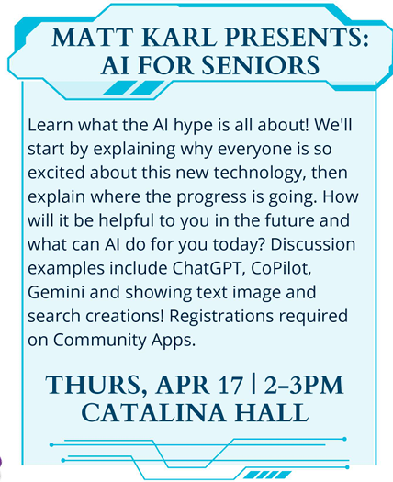

Slide 9
Fun Facts
Courtesy of Peter Stiles
Chance a large asteroid will strike Earth on December 22, 2032
Year in which U.S. deaths are projected to begin exceeding births
Chance that an American man convicted of a crime was older than 50 in 1990
… In 2023
Percentage of Americans who cannot distinguish between right and left
Percentage of U.S. engineers with Ph.D.s who were born abroad
Minimum number of monthly users of character.ai, a website that offers AI-generated conversation partners
1 in 32
2033
1 in 25
1 in 7
15%
56%
20,000,000
Avg 90 minutes per day
Source: Harper’s Index Apr 2025

Slide 10
Fun facts cont.
Hair from your head, measured as a single strand, grown over an average lifespan of 75 years – Length?
Hair on head – how much produced in a day?
Unravel DNA from one human cell - Length?
If DNA is fishing line stuffed into cell the size of a basketball - Length ?
3,500,000 ft (660 miles)
24 meters
(80 feet)
6.5 ft
100 km
(62 miles)
Source: Various

Slide 11
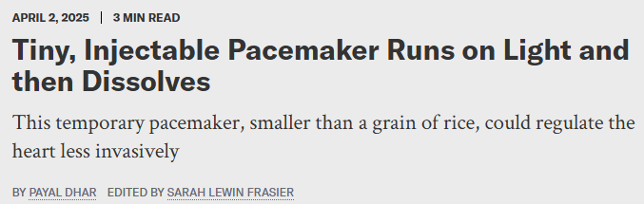
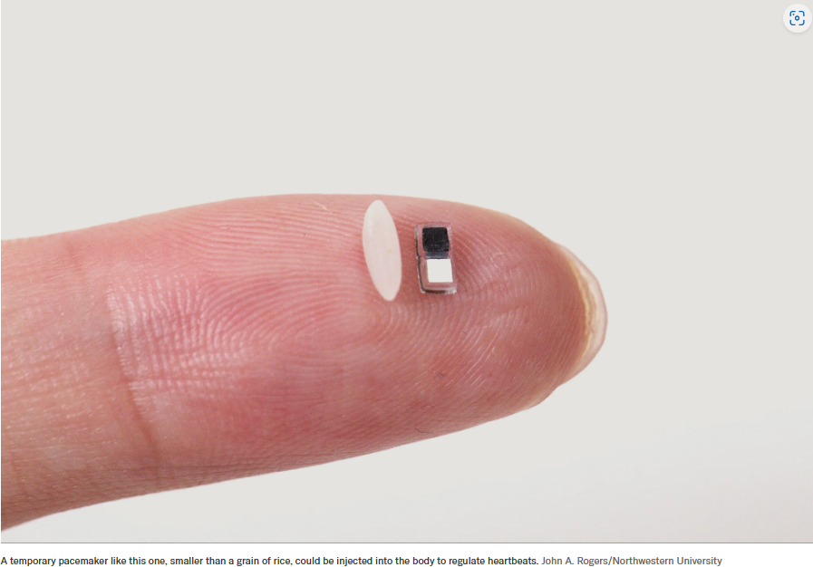
Click here to read story from Scientific American.

Slide 12
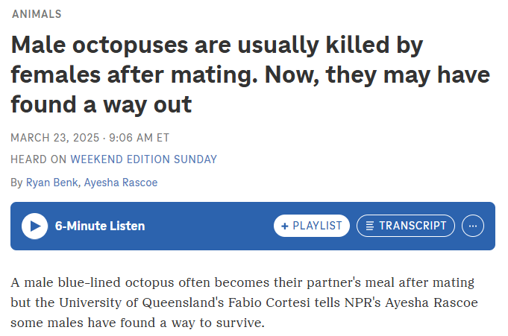

Slide 13
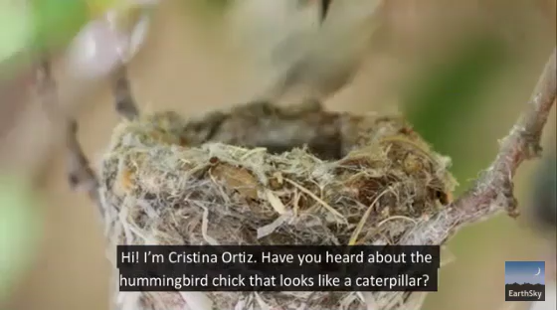
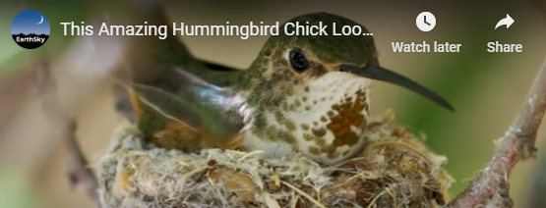
This amazing hummingbird chick looks like a caterpillar

Slide 14
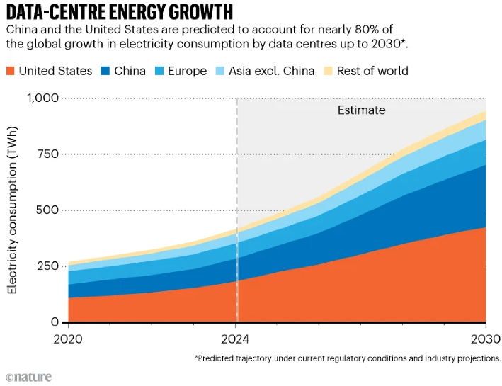

Slide 15
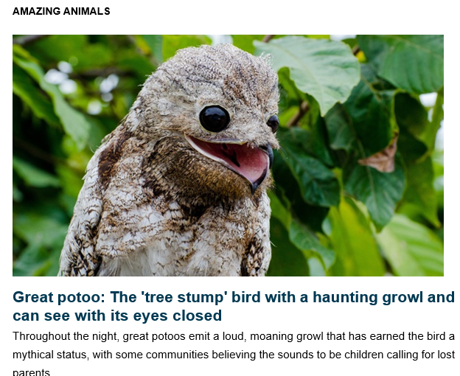
Great potoo: The 'tree stump' bird with a haunting growl and can see with its eyes closed | Live Science

Slide 16
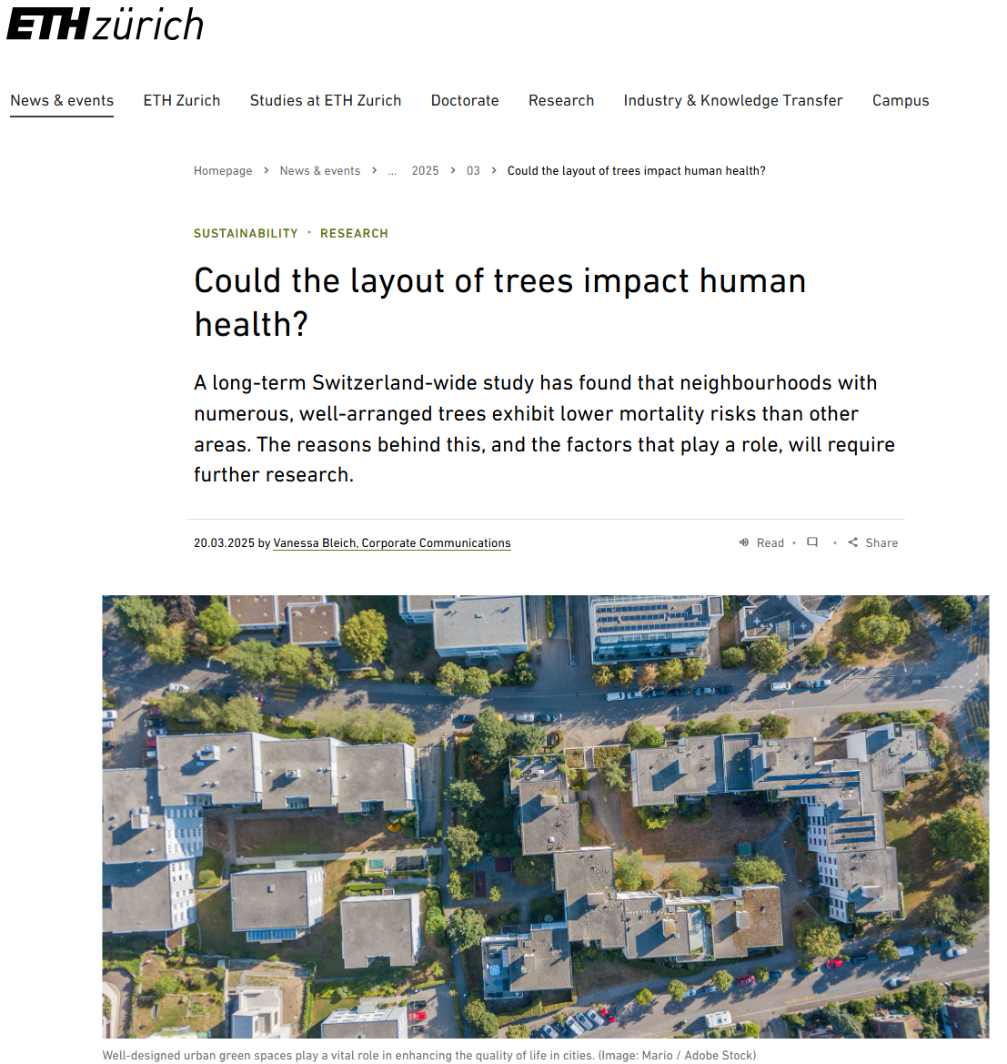
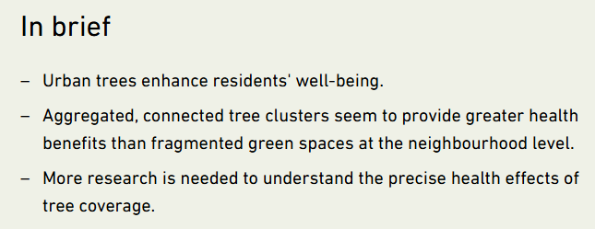

Slide 17

Read More

Slide 18
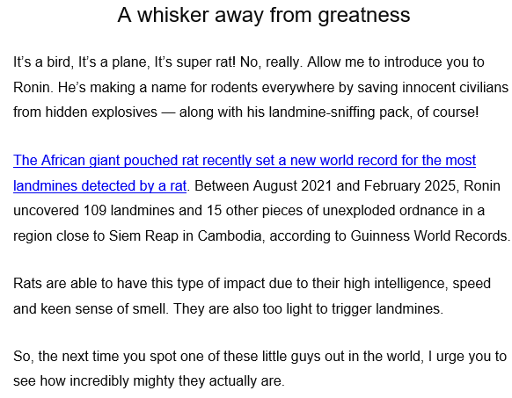


Slide 19
Yesterday’s Earthquake
Yesterday morning I was watching a presentation on Butterflies and moths by a friend of ours in Upstate New York through Binghamton University’s Lyceum program.
About 10:10 my phone starting making a huge sound and the screen turned bright red.
It said something about an earthquake and told me to “Drop, take cover, and hang on.”
I got up to tell Barbara when I felt the quake.
Also, at 10:10 I received an email earthquake alert from my Seismic Eruption program that runs continuously at CBS News in New York City.

Slide 20
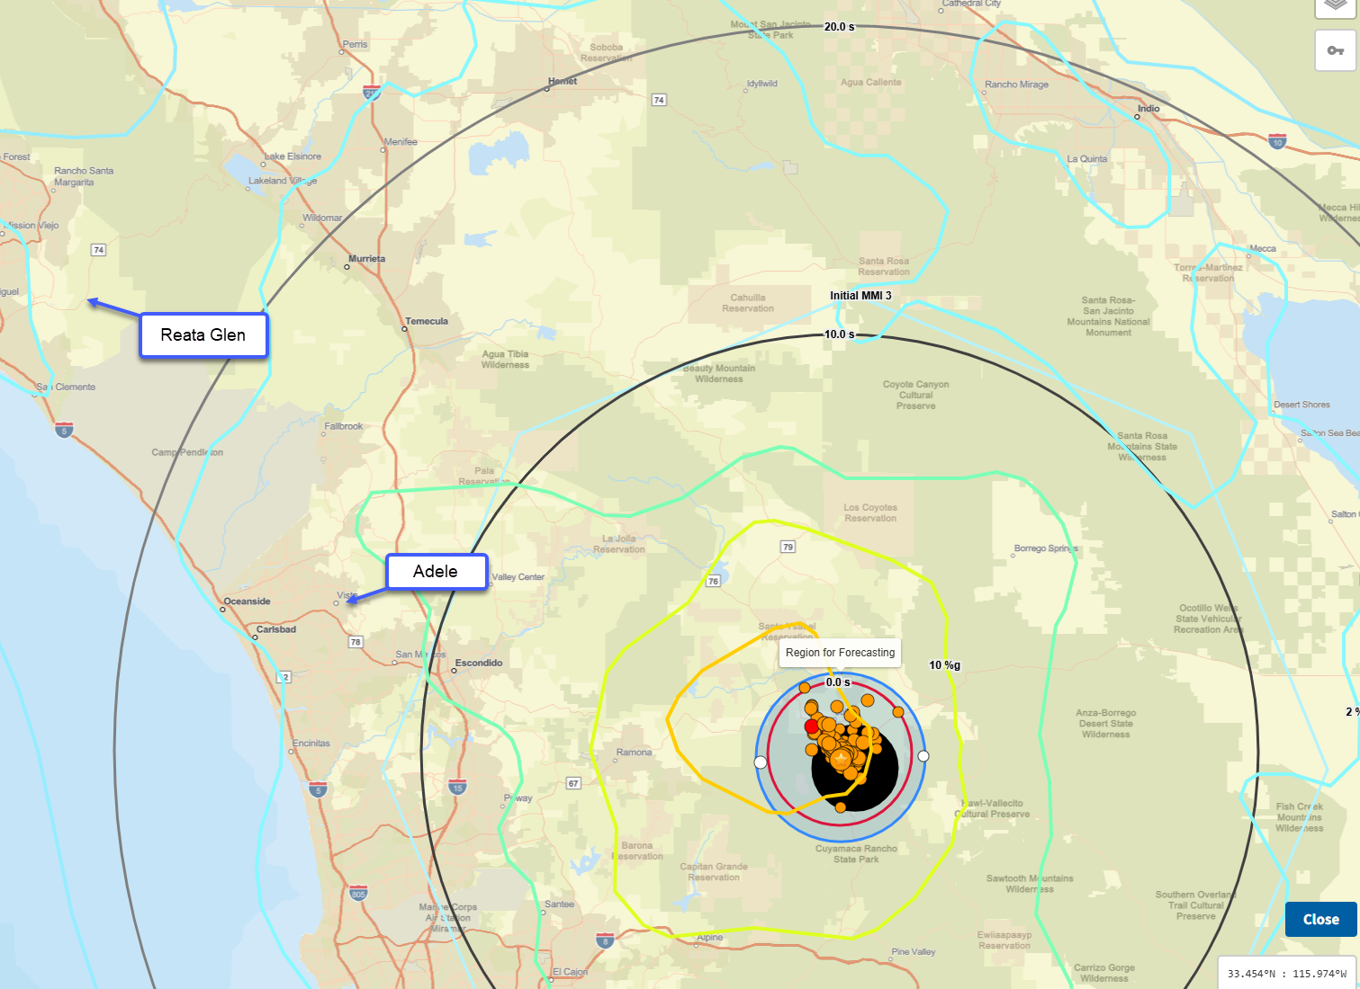
Reata Glen is about 65 miles from the epicenter. Adele is about 35 miles from the epicenter.

Slide 21
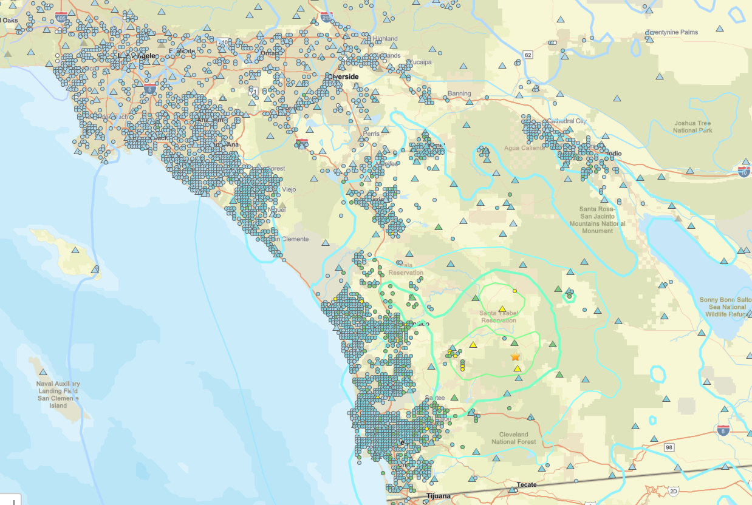
Seismic Stations

Slide 22
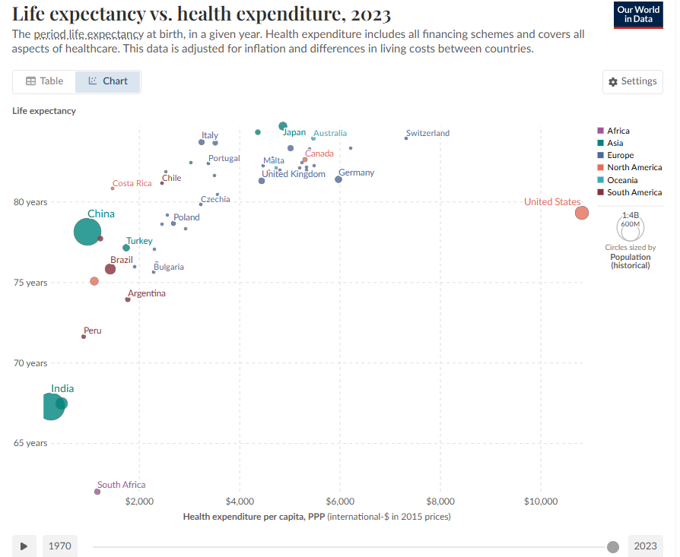
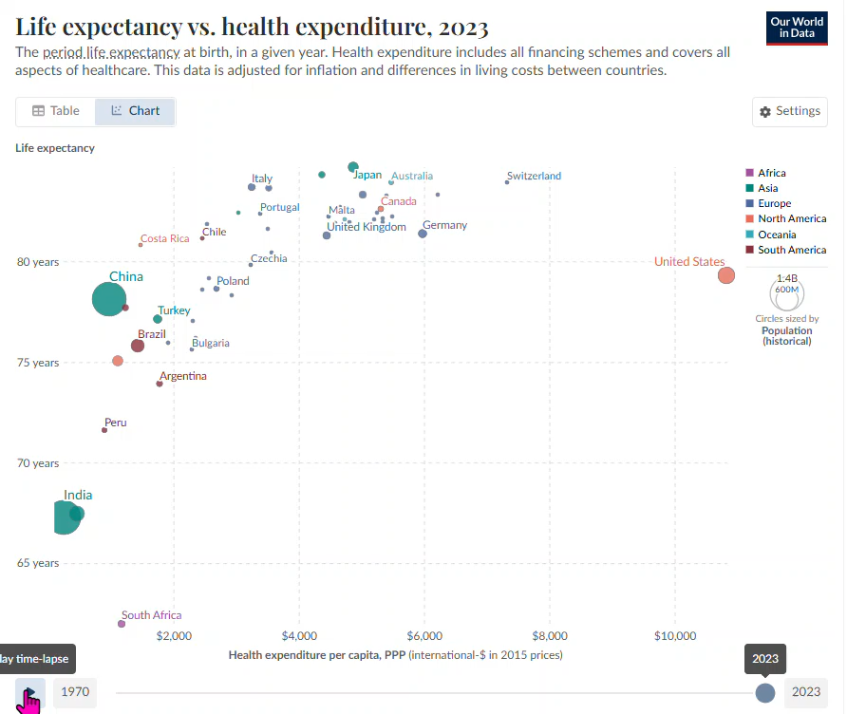
Life expectancy vs. health expenditure, 2023

Slide 23
HEALTHSPAN
My April Scientific American magazine arrived with a supplemental magazine:
HEALTHSPAN: The Science of Aging well.
How AI is redefining longevity
New research for disease prevention
Pioneering Healthspan doctors
You can download this supplement from:
https://www.scientificamerican.com/custom-media/healthspan/
There is no firewall!

Slide 24
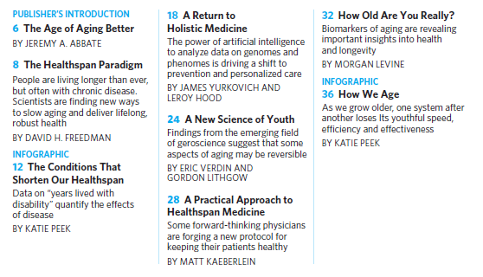
TABLE OF CONTENTS
Page 1

Slide 25
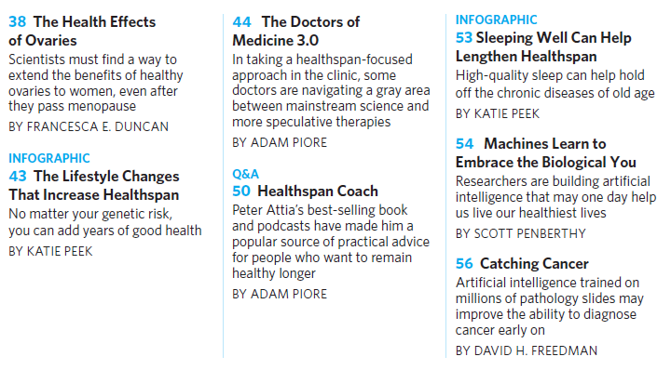
TABLE OF CONTENTS
Page 2

Slide 26
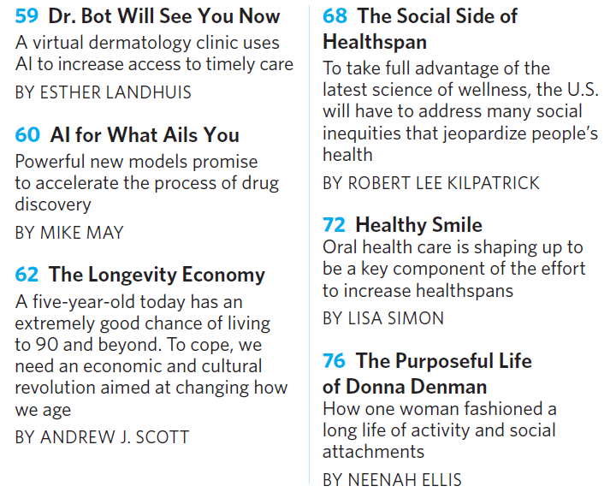
TABLE OF CONTENTS
Page 3

Slide 27
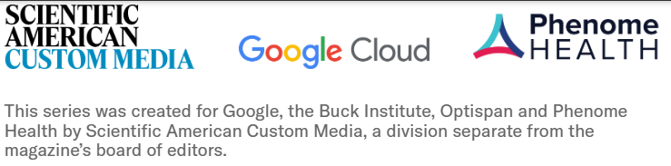

Slide 28
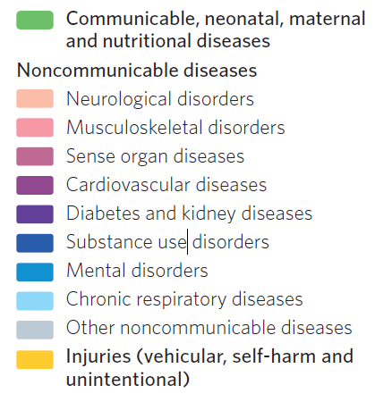
The Conditions that Shorten Our Healthspans
These items are the keys used in the next slide.

Slide 29
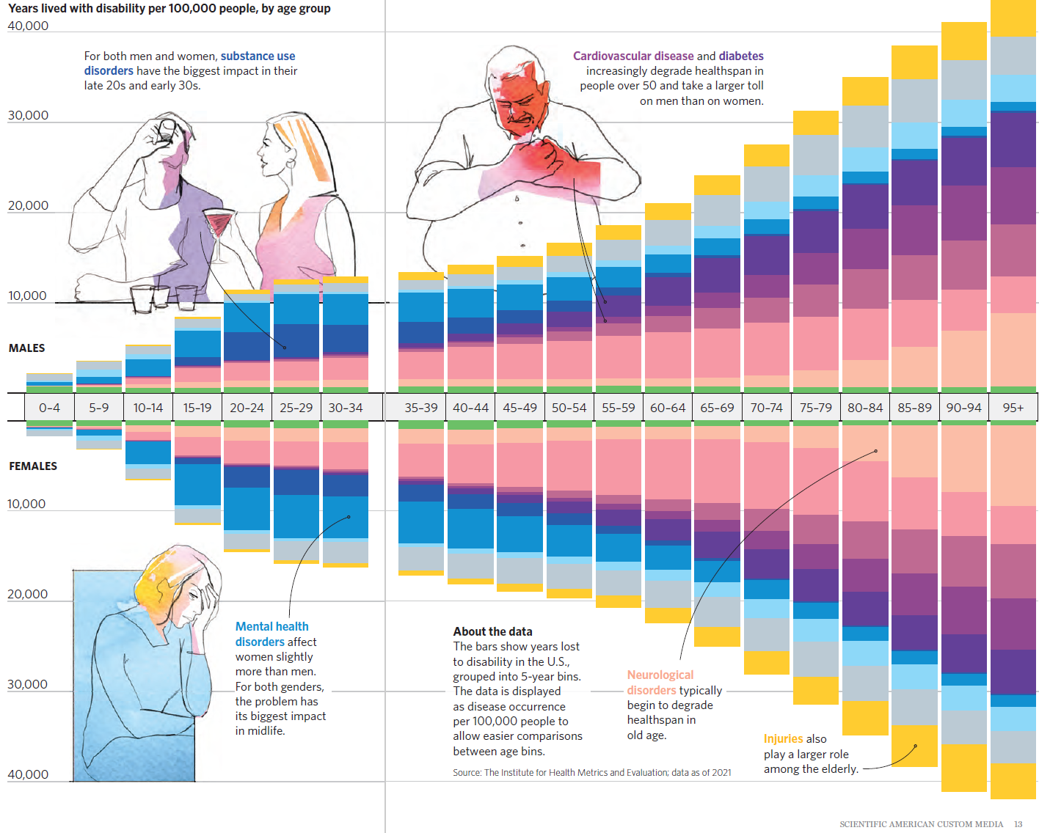
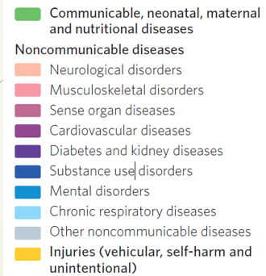

Slide 30
What do you think was the leading cause of death in:
1902
1952
2022
Tuberculosis
Heart Disease
Heart Disease

Slide 31
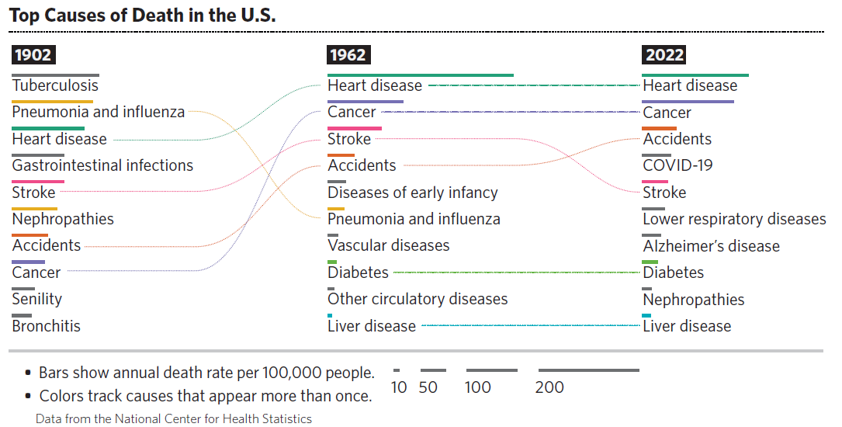

Slide 32
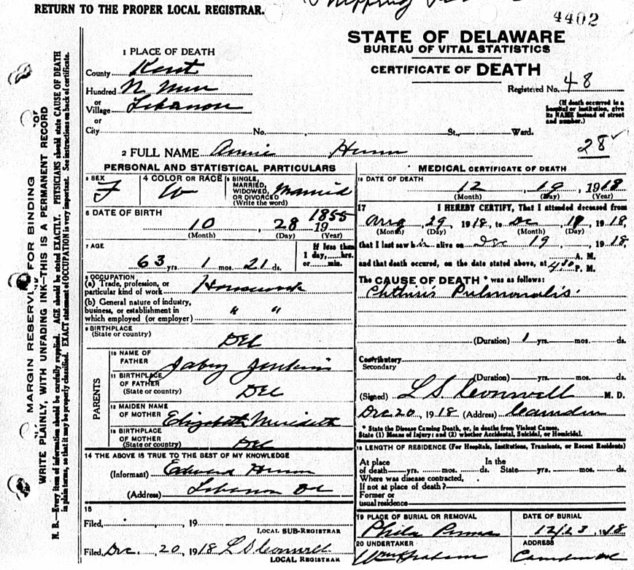

My great-grandmother, Anna Jenkins Hunn’s, death certificate. She died December 19, 1918.
I was told she died of the flu in the Spanish Flu epidemic of 1918.
Her death certificate shows that she died of Phthisis Pulmonalis, also known as Pulmonary Tuberculosis, which is a chronic infectious disease caused by the bacterium Mycobacterium tuberculosis.

Slide 33
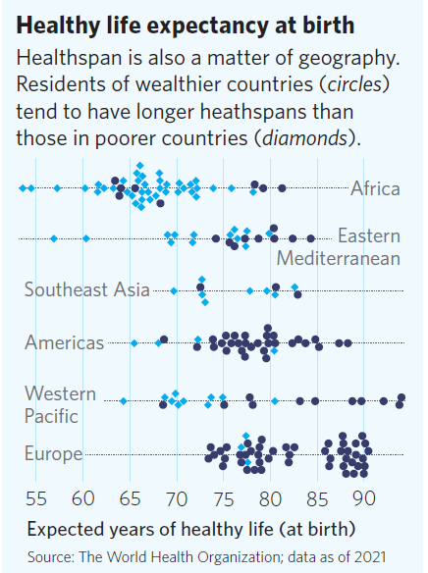

Slide 34
The effort to keep aging at bay focuses not on merely adding years to people’s lives, but on making those extra years healthy ones.
In the U.S., the average person can expect to experience nearly 13 years of relatively poor health in late life, compared to fewer than 11 years in 1990. This is because people are living longer but not better.

Slide 35
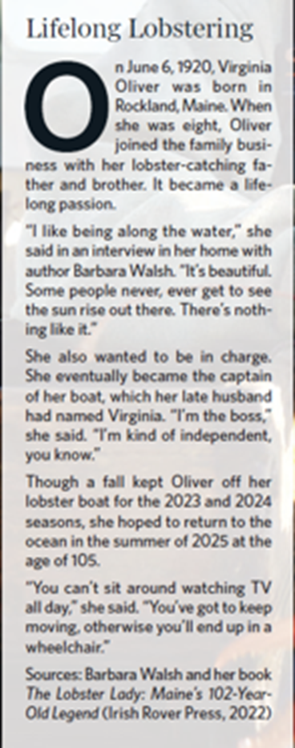
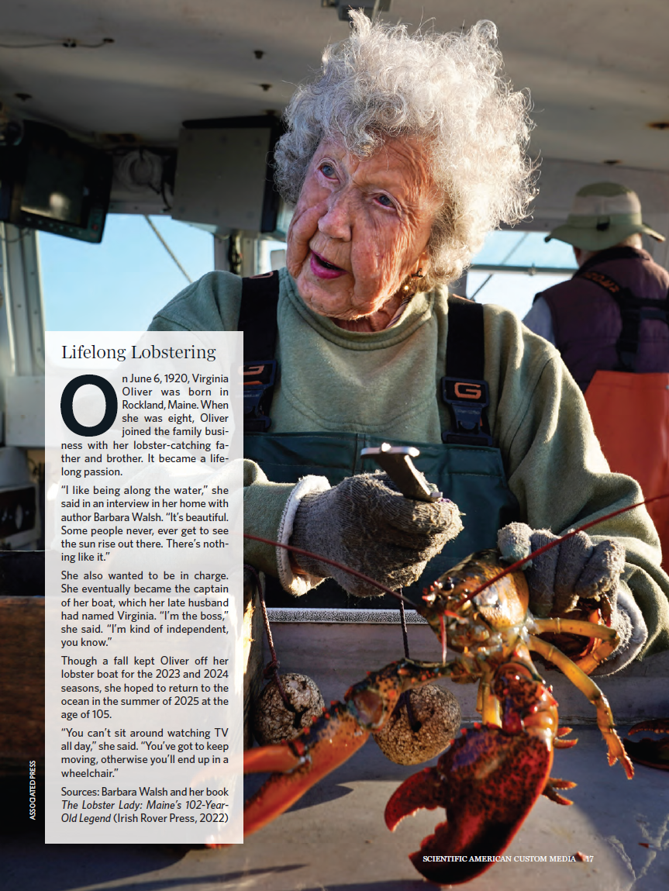

Slide 36
Lifestyle
Lifestyle plays an outsized role in preventive health.
Diet, exercise, sleep, stress and social support are all key factors.

Slide 37
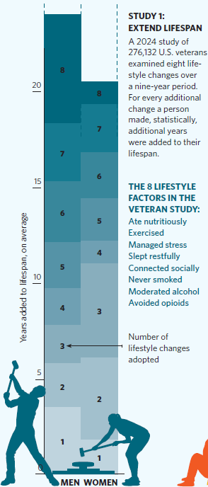
LIFESTYLE FACTORS IN THE VETERAN STUDY
Ate nutritiously
Exercised
Managed stress
Slept restfully
Connected socially
Never smoked
Moderated alcohol
Avoided opioids

Slide 38
Exercise
Adding or adjusting exercise may be an especially effective way to stretch healthspan, according to Keith Diaz, an associate professor at Columbia University Medical Center, and director of the Cardiology Division’s Exercise Testing Laboratory.
Diaz has run studies that show exercise can set back biological age by up to 30 years.
“The benefits go through every system,” he says.
“Just replacing 30 minutes of sitting with light-intensity exercise lowers the risk of death by 35 percent.”
“People who are older when they start exercising still get a payoff in improved health, including longevity and healthspan.”

Slide 39
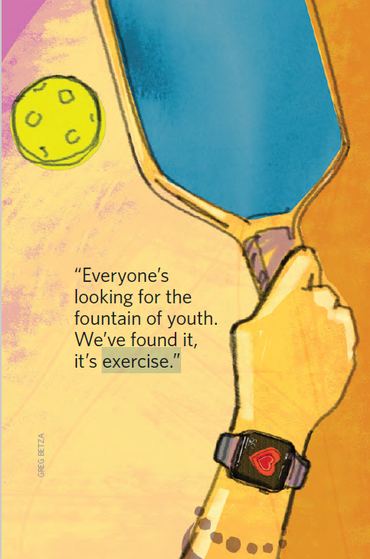
The racket sports are all good exercises.
However, there are lots of injuries from Pickleball.
Here, at Reata Glen we have three Pickleball courts. Residents playing Pickleball are encouraged to wear court shoes and not, for example, running shoes while playing.

Slide 40
Crossword Puzzles
30 minutes before class today, I received an email from National Geographic asking the question, “Do working crossword puzzles really keep you brain sharp?”
The conclusion is that lots of sharp, older people do crossword puzzles but there is no evidence that the crossword puzzles caused this.
Conclusion:
In the end, there’s nothing wrong with doing crossword puzzles. And the scientific evidence shows they’re far from cognitively bankrupt and even provide some beneficial mental stimulation. However, truly reducing your risk for dementia requires a multipronged approach that should always include plenty of consistent exercise. A strategy like this will likely offer far greater protection against cognitive decline than a single puzzle ever could.

Slide 41
Anti-Aging
Drugs known to slow aging in animals might well safely do the same for humans.
One of them, metformin, has already been approved by the FDA for testing as an anti-aging drug.
Others are being taken by hundreds of people outside official trials.
The key is to help people live into 90s – and in good health

Slide 42
Researchers are finding ways to gather and enlist vast streams of personal health data to help keep people sharp and active well beyond their 70s.
“The idea that you can be in your 90s and be mentally agile and physically robust is perfectly realistic,” says Leroy Hood, a biologist from the California Institute of Technology and University of Washington.
He helped pioneer the genomics revolution and is now CEO of the health-related nonprofit Phenome Health, as well as co-founder of the Institute for Systems Biology. (He’s 86.)

Slide 43
LIFESPAN: The number of years we live.
HEALTHSPAN: The years of life that remain free of serious disease.
From the article: “We don’t want to extend the period of decrepitude, that’s just making people sick for longer. Our goal is to extend lifespan while having the health of someone 20 years younger.”

Slide 44
Biological Age: the age your body says you are, as distinct from your calendar age.
The lower a person’s biological age is relative to chronological age, the better they are aging.
It was found that biological age was correlated with wellness, suggesting that it may be a more accurate indicator of health status than chronological age.
They can calculate the ages specific to each organ.

Slide 45
GENOME: An individual’s genetic makeup
PHENOME: The collection of all the dynamic characteristics of an individual’s biology.

Slide 46
A Return to Holistic Medicine
The power of artificial intelligence to analyze data on genomes and phenomes is driving a shift to prevention and personalized care
By sequencing each patient’s genome, a doctor can obtain advance warning of disease risks and information on the relative efficacy of different treatments.
By routinely gathering tens of thousands of signals on a patient’s physiology, behaviors and environmental exposures, the doctor can come to a deep understanding of a patient’s phenome—the collection of all the dynamic characteristics of an individual’s biology.

Slide 47
My question: Where do the data come from?
The article spent very little time on how the data are collected.
It seems to me that the AI would have to be integrated with the patient’s online chart.
In addition, it would have to be in communication with the patient’s physician. For example, it might tell the physician what tests to order up.
There was passing mention in the article about wearables for collecting the data such as a glucose monitor.

Slide 48
Google AI Search: “Tell me about the Apple iPhone AI that gives health outlooks.” AI Mode is experimental and can make mistakes. Learn more
Apple is reportedly working on a significant revamp of its Health app, incorporating AI to provide users with more proactive and personalized health insights and recommendations. This initiative, sometimes unofficially referred to as "Health+", is expected to offer features similar to having an "AI doctor" or "health coach" within the app.

Slide 49
By sequencing each patient’s genome, a doctor can obtain advance warning of disease risks and information on the relative efficacy of different treatments.
By routinely gathering tens of thousands of signals on a patient’s physiology, behaviors and environmental exposures, the doctor can come to a deep understanding of a patient’s phenome—the collection of all the dynamic characteristics of an individual’s biology.

Slide 50
Example of Lifestyle Interventions
Those with genes that confer a high risk for high LDL cholesterol (a proxy for heart disease) can only bring it down by using drugs such as statins.
In contrast, for those with low-risk LDL genes, diet and exercise can suffice.
This raises the possibility that treatments should vary from one person to the next depending on their genetic profiles.

Slide 51
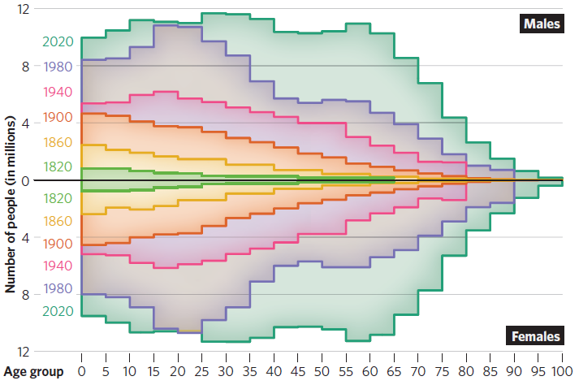
The shifting age distribution of the U.S. population

Slide 52
The Doctors of Medicine 3.0
Many doctors are testing patients to find their biological age.
Medicine 2.0 is based on letting things break and then try to fix.
Medicine 3.0’s main emphasis is on prevention.
A lot has been learned about aging. These doctors are applying that knowledge.
Testing, testing, testing.
For example, DEXA can measure the amount of fat, lean tissue, and bone in the body.
Using AI, the results of tests are compared with lots and lots of testing data.

Slide 53
Once they assess their patients, almost all doctors who practice Medicine 3.0 begin with the basics, focusing on optimizing their diets, sleep habits, stress-reduction techniques and emotional well-being.
There is nothing speculative about the benefits of these interventions—primary care doctors often give the same advice.
The difference is that Medicine 3.0 doctors put an emphasis on these steps to prevent disease.
They often suggest their patients use unregulated supplements.
Probiotics and phytonutrients are known to be good for the body, but there is a lack of clinical data to establish that, if taken as supplements, they will survive the human digestion system and liver metabolism.
Many people have hormonal imbalances caused by aging. Hormone replacement therapy can make a big difference.

Slide 54
More controversially, some doctors prescribe experimental medicines designed to hack the biology of aging such as: Rapamycin, metformin, and drugs aimed at modulating nicotinamide adenine dimucleotide (NAD), an organic molecule that plays a key role in cellular metabolism and energy production.
Rapamycin is widely prescribed off-label. The drug is approved as an anti-cancer therapy and to inhibit organ rejection in transplant patients.
Metformin, a diabetes drug used to lower blood sugar, may also protect cells from damage caused by unstable molecules known as free radicals and beneficial effects on blood vessel health that could extend life.

Slide 55
The article on Medicine 3.0 ends with this statement:
Medicine 3.0 doctors do agree on one therapy, which has zero side effects: placebo. “You can make a reasoned argument that if people take these things and suddenly feel better, even if it’s not the active ingredient in the supplement,” says Kaeberlein. “Is that a bad thing? I don’t know. I mean, if it helps, it helps, right?”

Slide 56
Next Session: Tuesday May 20, 2:00 p.m.

